Slide 1
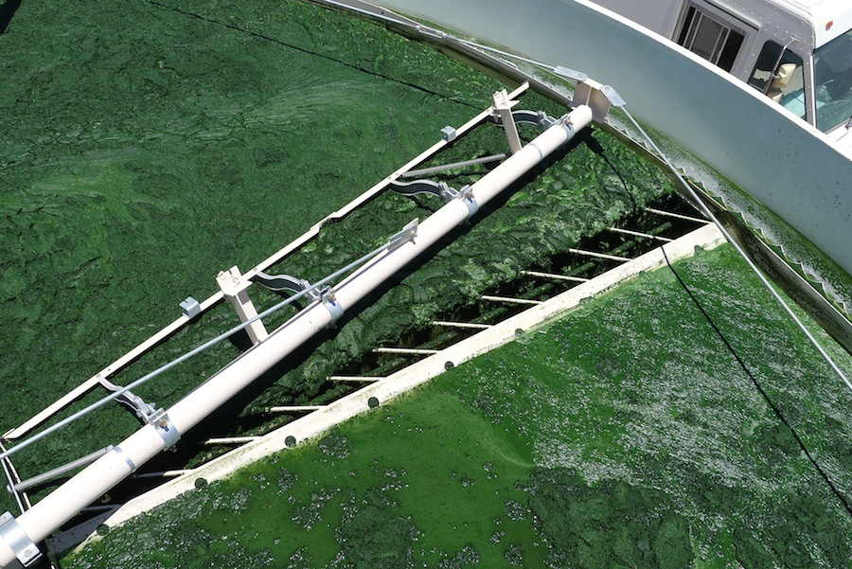
Improving the energy balance of an integrated wastewater treatment process
Francesco Ometto ATWARM Conference – Dublin
15th May 2013

Slide 2
Project aim
The aim of this work was to evaluate the energy demand and balance of an integrated microalgal wastewater treatment plant using different hypothetical scenarios.
Wastewater
Residual
N and P
AD
Energy
generation
Algal treatment
Clarified Water
Activated Sludge
(AS)
Raceway Algae Pond
Harvesting unit
Pre-
treatment
Anaerobic
Digestion

Slide 3
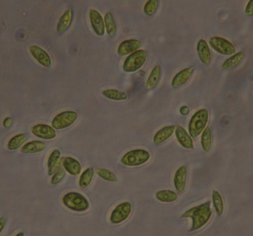
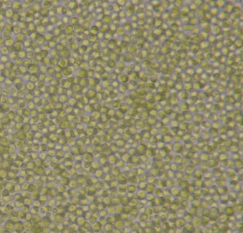
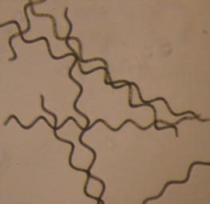
HARVESTING ISSUES
Particle size/shape
AOM (Algogenic Organic Matter)
S. obliquus
C. vulgaris
A. maxima

Slide 4
Harvesting
BDAF - Ballasted Dissolved Air Flotation
(0.04 kWh m⁻³)
HARVESTING
Floc & bead aggregate
Sludge scraper
Hydrocyclone to separate floc and bead
Separated beads leave from top & are recycled
Micro beads
New bead added to make up for any loss during recycle
Clarified water
Recycled bead are
Flocculated material sinks to
introduced at base of
Bead pump
Bead recycle line
be removed from the base
flocculation zone
60-80% less energy compare to DAF

Slide 5
HARVESTING
DAF vs BDAF performance
S. obliquus cultivated in Jaworski Media
DAF
BDAF
40% reduction on coagulant addition

Slide 6
AD and pre-treatments
Wastewater
Residual
N and P
AD
Energy
generation
Algal treatment
Clarified Water
Activated Sludge
(AS)
Raceway Algae Pond
Harvesting unit
Pre-
treatment
Anaerobic
Digestion

Slide 7
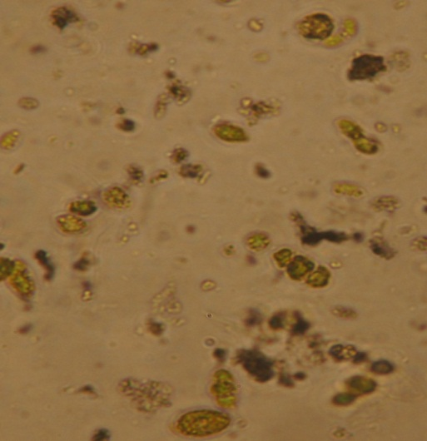
DIGESTION ISSUES
Algae cell wall
- Strong resistance to bacteria degradation
Limited biogas production
Residual intact cell after digestion (40d)
RESIDUAL CELL
Pre-treatment to improve AD
Thermal Hydrolysis (TH):
efficient sludge pre-treatment;
efficient combination of temperature and pressure to strongly effect the algal cell structure;
Enzymes :
low energy treatment;
low knowledge;

Slide 8
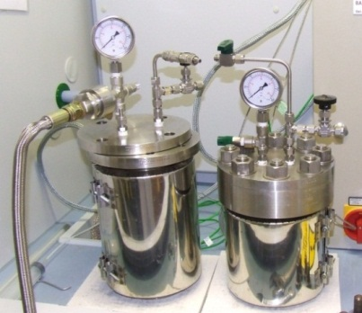
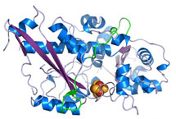
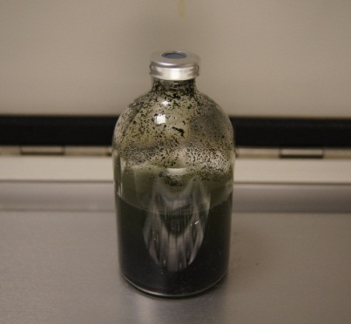
DIGESTION
Experimental condition
Thermal Hydrolysis (TH) system
(autocleave and steam generator):
Algal sample 2% TS at 165°C/8 bar for 30min
sCOD, sProteins, sCarbohydrates
Baskerville (Manchester, UK)
Enzymes
Algal sample 2% TS at 50°C, pH 6 for 24h
sCOD, sProteins, sCarbohydrates
BioMethane Test (BMT):
40ml of sample at VS_{seed}:VS_{substarte} = 1:1
20ml nutrient solution*
38°C at 135rpm
Methane/Biogas analyses avery 2-4 days
* Angelidaki, I., Alves, M., Bolzonella, D., Borzacconi, L., Campos, J.L., Guwy, A.J., Kalyuzhnyi, S., Jenicek, P., van Lier J.B.: Defining the biomethane potential (BMP) of solid organic waste and energy crops: a proposed protocol for batch assays. Water Sci. Technol. 59, 927-934 (2009)

Slide 9
DIGESTION
Treatments effect (sCOD)

Slide 10
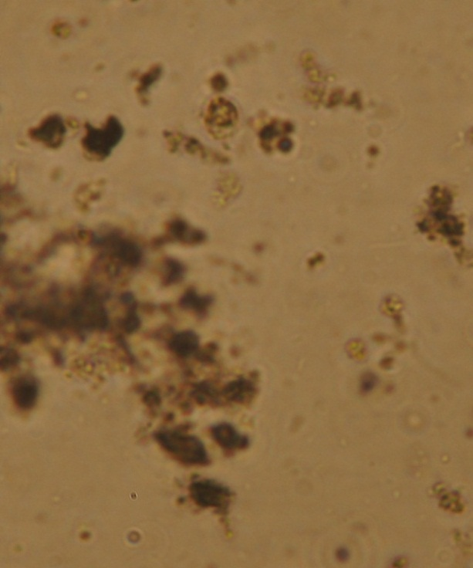
DIGESTION
Biogas production (TH pre-treatment)
DIGESTED CELL

Slide 11
Energy balance
Wastewater
Residual
N and P
AD
Energy
generation
Algal treatment
Clarified Water
Activated Sludge
(AS)
Raceway Algae Pond
Harvesting unit
Pre-
treatment
Anaerobic
Digestion

Slide 12
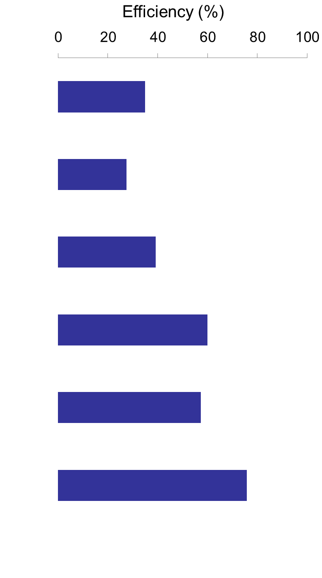
Energy Balance TP230K
Net Energy Balance
(MWh d⁻¹)
Plant Efficiency
(%)
11.30
DAF
21.98
21.98 (+17.68)
BDAF
12.94
12.94 (+1.64)
9.72
DAF
15.86 (+6.14)
BDAF
6.82 (-2.90)
Full data available: Ometto et all., 2013 “Improving the Energy Balance of an Integrated Microalgal Wastewater Treatment Process”, Waste and Biomass Valorization, DOI: 10.1007/s12649-013-9230-2

Slide 13
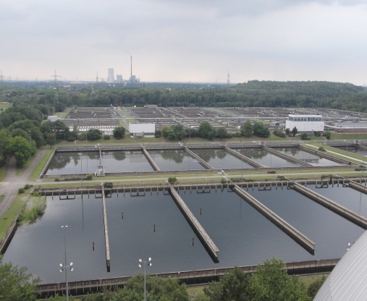
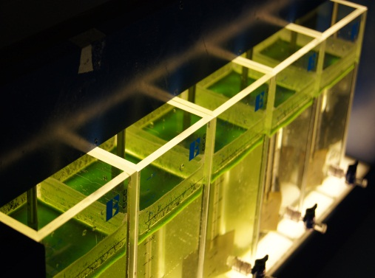
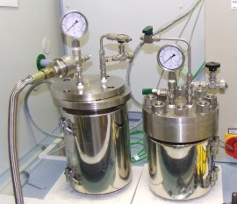
Conclusions
WWTP balance:
Inclusion of an algae reacotor can generate a more sustainable treatment plant with improved efficiency ranging from 55% (TP25K) to 75% (TP230K).
Harvesting:
- Importance of AOM, particle size and scape;
60-80% energy reduction and 40% coagulant demand reduction using BDAF compare to traditional DAF;
AD pre-treatment:
TH improved the biogas production by 90%.
TH improved the energy production by 50-60%.
Lower condition can be effective depending on the algal characteristics;
Enzymes are a species specific potential alternative;

Slide 14
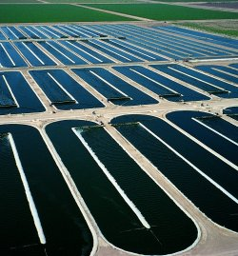
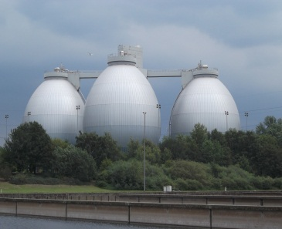
Future works
How cultivate algae?
PBR
Open pond
Efficiency
Ballasted flotation
- Pilot plant
Pre-treatments
Pilot plant
Algae/Primary Sludge

Slide 15
Thanks for your attention
‟Nothing in life is to be feared, it is only to be understood.”
Marie Curie (1867-1934)
Project founded by EU Framework 7 project
Advance Technologies for Water Resources and Management (ATWARM), Marie Curie ITN, No. 238273.
Coordinated by QUESTOR Centre, Queen’s University – Belfast (UK)

