Slide 1
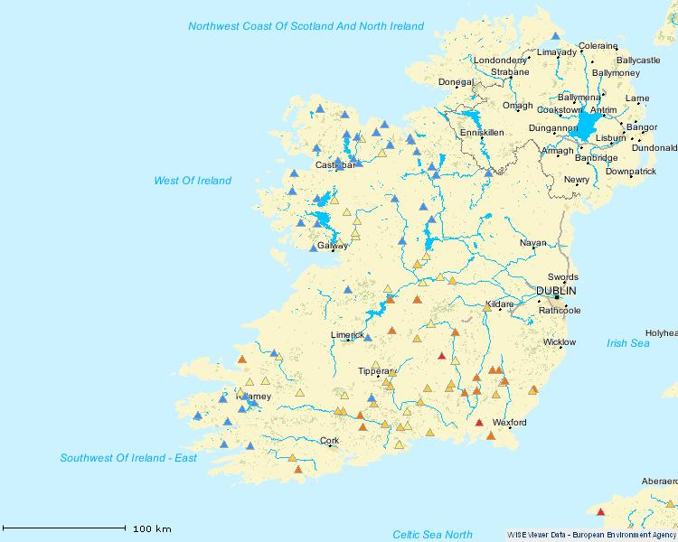
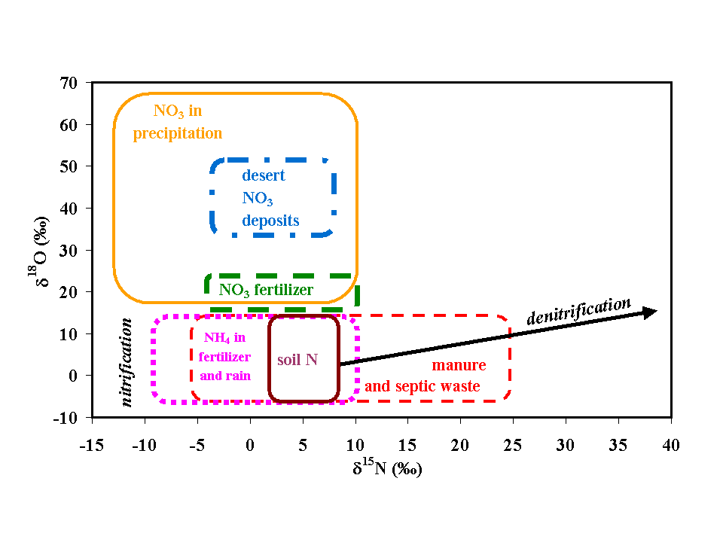
Assessment of integrating stable isotope data and data on pharmaceuticals to disentangle sources of nitrate pollution
Cecilia Fenech¹, Dr Luc Rock², Dr Kieran Nolan³, Dr Anne Morrissey⁴ , Dr John Tobin¹
¹School of Biotechnology, DCU; ²Queen’s University, Belfast; ³School of Chemical Sciences, DCU; ⁴Oscail, DCU
Within Europe, sewage and diffuse agricultural sources are considered to be the main threat to water quality [1].
Elevated nitrate levels affect aquatic ecosystems and give rise to health considerations in living organisms.
Within Ireland, rivers in the southeast contain the highest levels of nitrate concentrations. Similar observations can be made for Northern Ireland (Figure 1).
The whole island of Ireland is designated as a Nitrate Vulnerable Zone under the Nitrates Directive (91/676/EEC).
Background
Figure 1: Mean Annual
Nitrates in Rivers, RoI, [2].
Inset: N. Ireland, 2005 [3].
Figure 2: Ranges of δ¹⁸O and δ¹⁵N values of nitrate from different sources [4].
Most nitrate sources can be determined on the basis of the nitrogen (N) and oxygen (O) isotopic compositions (δ¹⁸O and δ¹⁵N ) of nitrate (Figure 2).
Sewage and manure have overlapping δ¹⁸O and δ¹⁵N values making their differentiation on this basis problematic.
The use of co-occurring discriminators of nitrate sources, such as pharmaceuticals, could allow for sewage and manure nitrate sources to be distinguished.
Nitrate Source Determination
Actions for the remediation of contaminated sites can be targeted to the actual source making them more effective.
Water quality management can be improved.
Public health considerations can be reduced.
The ‘polluter pays principle’ can be applied more effectively since the source of the nitrate contamination is known.
The careful selection of distinct human and veterinary pharmaceutical identifiers provides for an additional dimension to the determination of the source of nitrate pollution.
Baseline data generated from single use watersheds could be used to assess the origin and fate of nitrate in more complex, multi land use watersheds.
Suite of human and veterinary pharmaceuticals determined.
SPE-LC-MS/MS methods developed.
Samples collected from single land-use watersheds.
Samples analysed for δ¹⁸O, δ¹⁵N and pharmaceuticals.
Model developed based on database generated.
Model applied to multi land-use watersheds.
Project Plan
The Project
Importance of Source Determination
An analytical method for the simultaneous detection and identification of human and veterinary pharmaceuticals.
A novel monitoring database on pharmaceutical presence and concentrations, and the nitrate δ¹⁸O and δ¹⁵N compositions of water bodies in the island of Ireland.
A model that allows the sources of nitrate pollution to be disentangled, which can be used in other nitrate sensitive regions.
Project Outcomes
[1] EEA 2010. The European Environment: State and Outlook 2010: Freshwater Quality. Copenhagen: Publications Office of the European Union.
[2] EEA. Mean Annual Nitrates in Rivers (WISE SoE) [Online]. Available from: http://www.eea. europa.eu/themes/water/interactive/soe-ri-ni [Accessed 20/12/2010].
[3] DOENI 2009. River basin management plans: groundwater classification: Nitrate. WFDGW6.
[4] Kendall, C. Tracing sources of agricultural N using isotopic techniques: The state of science [Online]. Available from: www.epa.gov/osp/presentations/afo/13_​Kendall.ppt [Accessed 15/12/2010].
cecilia.fenech@dcu.ie
Supported by: Contact: anne.morissey@dcu.ie
john.tobin@dcu.ie

